Slide 1
Microservices in Azure Kick-off
What The Hack

Slide 2
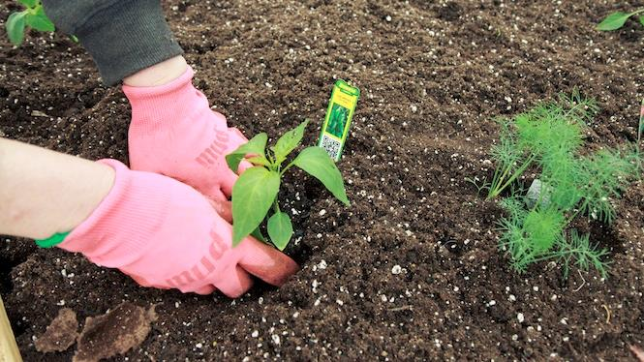
You will get your hands dirty
Notes:
You only get out what you put in, don't be lazy.
Knowledge Retention through Pain and Discomfort

Slide 3
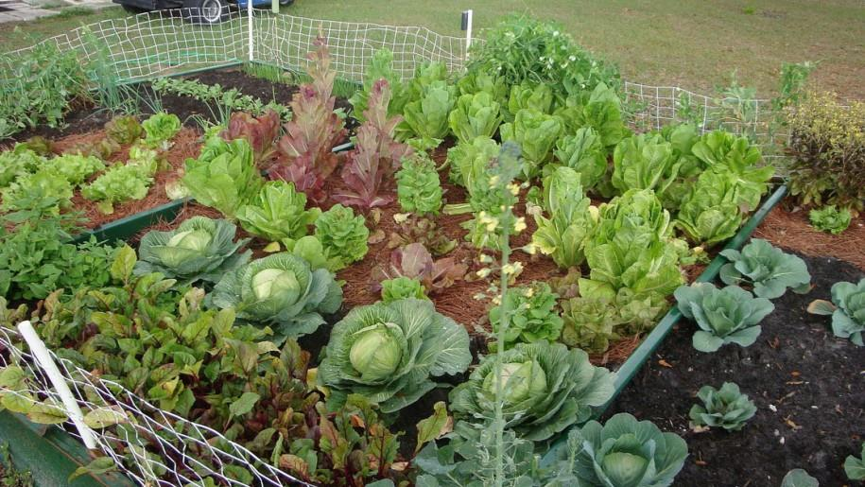
*results may vary
Notes:
You might not grow a garden like this… but at least you can learn while trying.

Slide 4

Logistics
Notes:
And now we’ll cover logistics…

Slide 5
Student Guide
Please download your student guide from here:
aka.ms/msoa-challenges

Slide 6
Format
aka.ms/msoa-challenges
Challenges are cumulative, building upon each other.
Establish Confidence – start small and simple (think hello world)
Build Competence – by having successively more complex challenges
Challenges are NOT step-by-step hands on labs!
No “clicking here” or “copy n pasting there”
Challenge definitions are short. A couple of sentences or bullet points stating the end goal(s) and perhaps a hint at the skill(s) needed.
You MUST work together as a team to figure out how to complete them!

Slide 7
Format
aka.ms/msoa-challenges
For each challenge we will deliver a ”mini-lecture” explaining concepts in it.
We’ll review results for each challenge when it looks like a majority of folks have completed the challenge
Don’t be beholden by the clock!
Move quickly or take it slow.
Your proctors are here to help you.

Slide 8
Proctors
aka.ms/msoa-challenges
You will have proctors through-out the whole hack.
Use them! But don’t expect them to give you all the answers.
Get to know your proctor, their likes and dislikes...
All the better to find a bribe that works!
Notes:
Keep the teams working as teams!
Encourage all to “learn from” and “share with” each other!
If you observe individuals racing ahead, encourage them to help those who are behind.
Encourage attendees to use their team’s channel on MS Teams to collaborate/share info!
Unblock teams who get stuck
Encourage team members to unblock each other first!
Provide hints, but not answers
If you observe individuals stuck for a while, help them get moving so they don’t lose interest.
Provide hints/pointers to the teams on how to solve problems & where to find information.
Use the answers/solutions in the proctor’s guide, but don’t share with the attendees
Proctor’s guide won’t be comprehensive. As SMEs, proctors should use their knowledge to help with solution hints/ideas.
Notify the emcee of unexpected blockers that arise during the event so they can be communicated to all, and recorded for future reference.

Slide 9
Tooling
aka.ms/msoa-challenges
You can use any tooling you want, but we strongly encourage (and will only support the following):
Azure Cloud Shell
Azure CLI in the Cloud Shell
Azure Portal

Slide 10
Finding Answers
aka.ms/msoa-challenges
Search engines are your friend! Azure is a hot technology and much ink has been spilled on it.
The Azure docs are your best bet.
Many of the related open source projects used here have top notch documentation!

Slide 11

And now death by Power Point…

Slide 12
And now death by Power Point… (just kidding!)

Slide 13
Contoso Travel Web Overview
1 Web App
App Service
2 REST Services (Data and Itinerary)
Container Instance
1 Data Load program
Container Instance
1 Cosmos DB Account
1 Database
Individual Scalable Document Collections for Domain Isolation
App Insights to Monitor

Slide 14
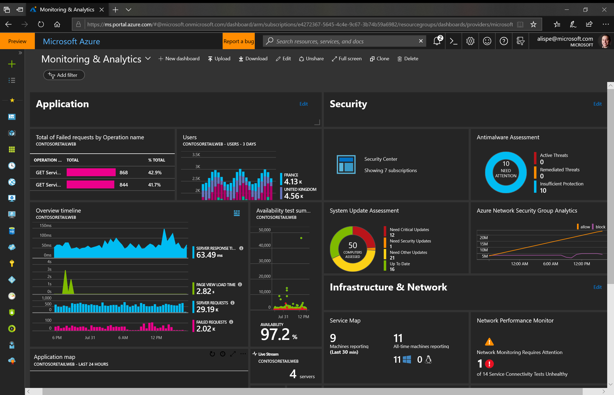
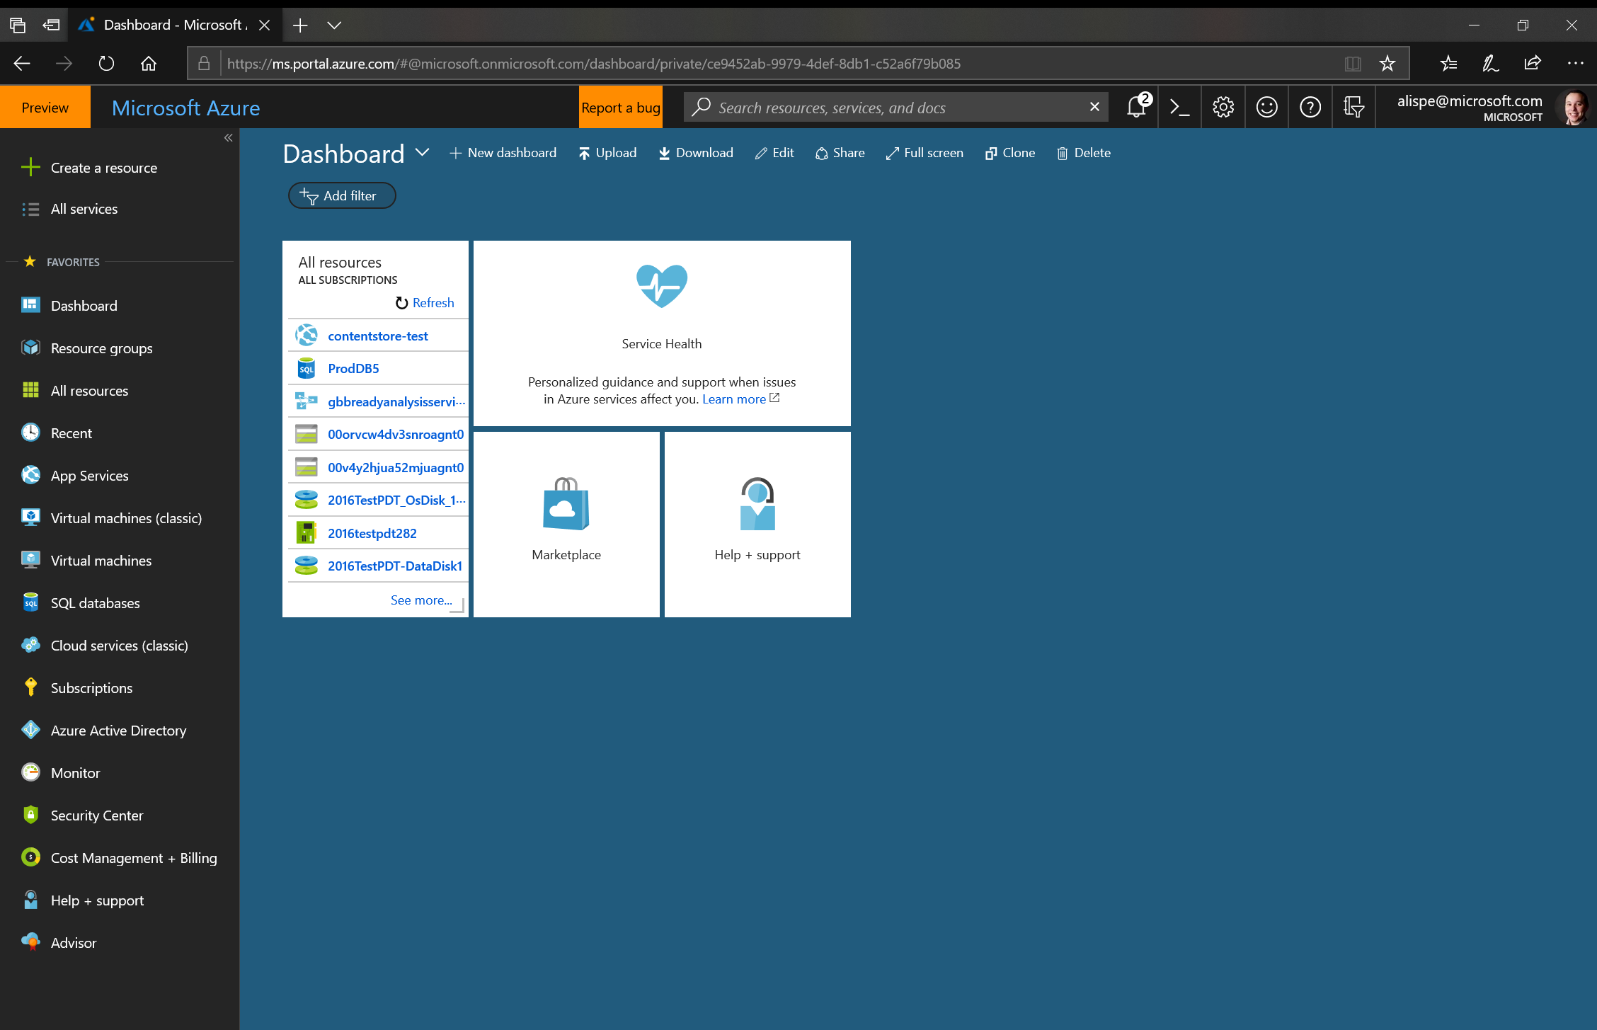
Azure Portal —portal.azure.com
See all your resources
Create portal dashboards by:
key roles
key projects
key service KPIs
Use the Azure Cloud Shell!
Notes:
Central place to deploy and manage Azure resources​
Unified browser experience for various management operations​
Management web pages (referred to as blades) includes settings, actions, billing information, health monitoring, usage data, and more​
Customizable dashboards

Slide 15
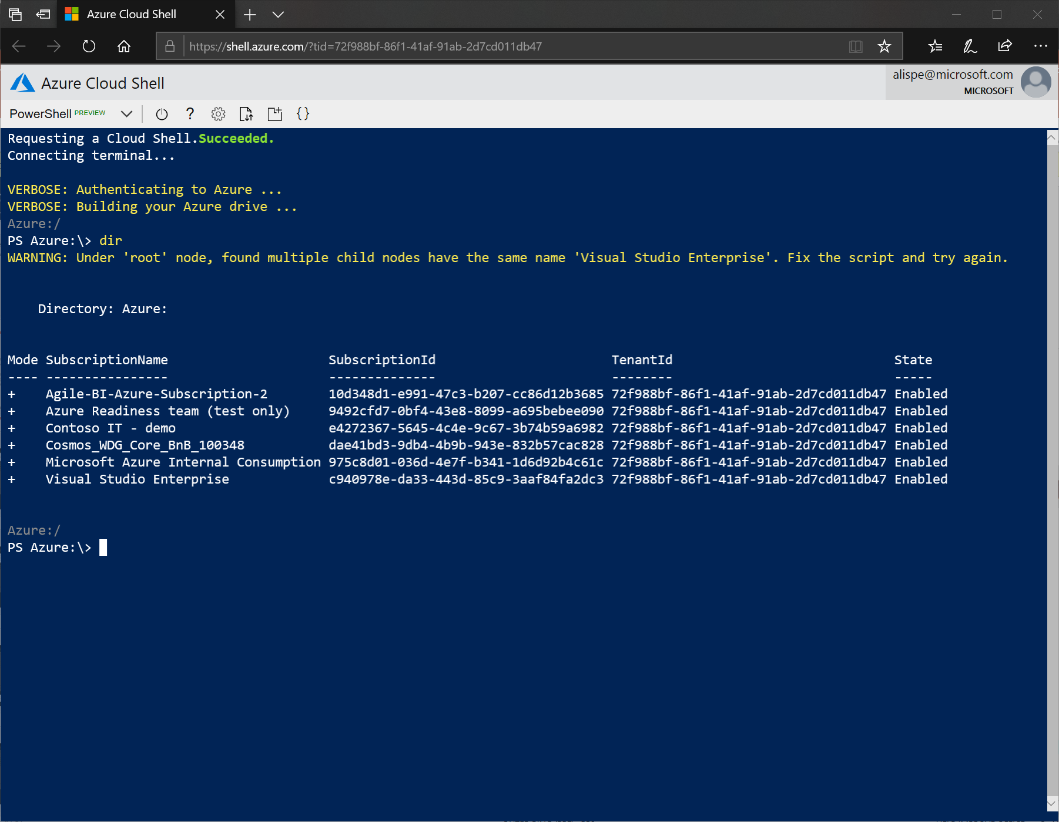
Azure Cloud Shell
Shell access from virtually anywhere
Common tools and programming languages included
Persist your files in attached cloud storage
Create and edit files in the Cloud Shell editor
Notes:
Support for PowerShell and Bash scripting and SDK for common languages and frameworks
Azure Resource Manager (ARM templates)
Browser-based command line— Cloud Shell (shell.azure.com)
Azure CLI is installed

Slide 16
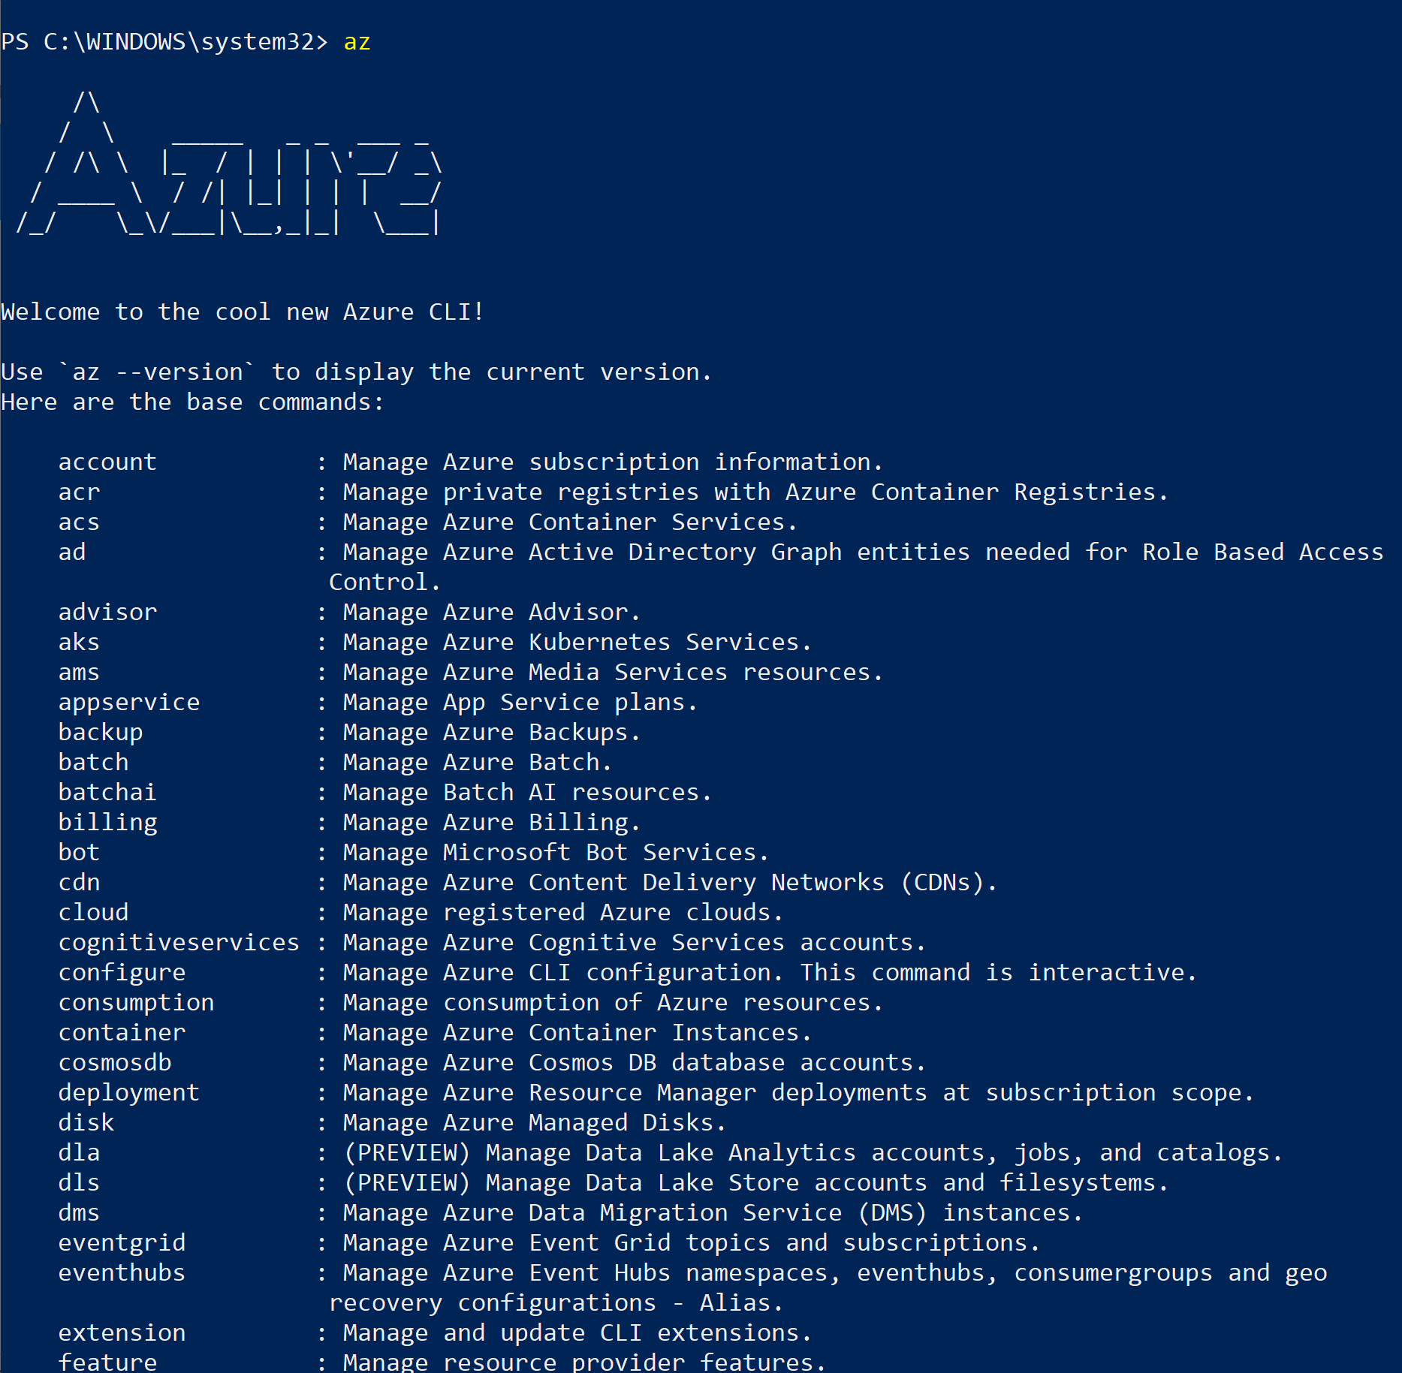
Azure CLI
Command Line Interface for Azure
Create/Manage/Query various Services
Cross Platform

Slide 17
Challenge 0 - Pre-requisites
Ready, Set, Go!
Form Your Team!
Download the Student Guide
aka.ms/msoa-challenges
Join the MS Teams Channel (if applicable)
Login to the Azure Portal
In another window, login to the Azure Cloud Shell
List your subscriptions with the Azure CLI

Slide 18
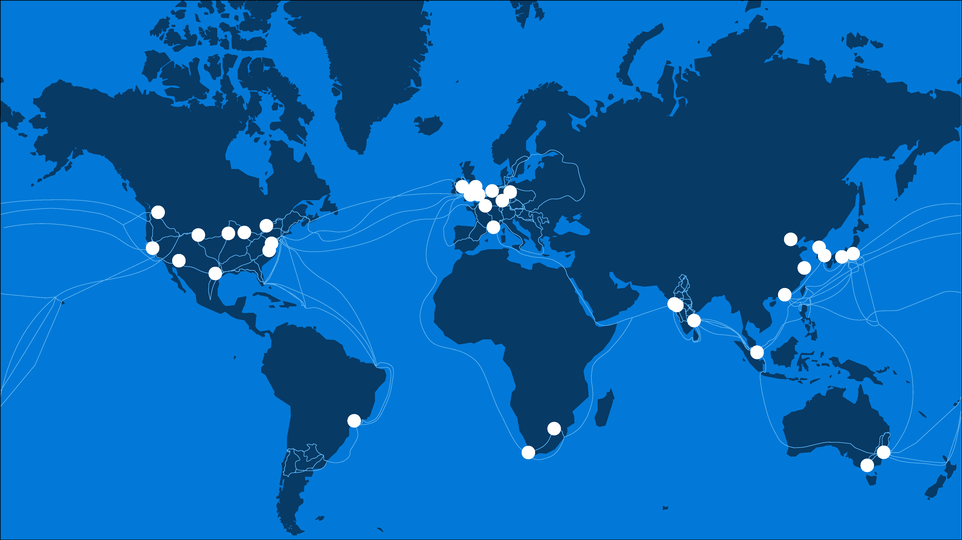
54
Azure regions
Notes:
In order to help organizations meet data residency, sovereignty and compliance requirements, Microsoft has a worldwide network of 42 Microsoft-managed Azure regions operations and plans for 12 additional regions and continues to make significant investments in geo-expansion through our local and sovereign offerings in more than 10 unique geographic regions worldwide.

Slide 19
2 Mil miles intra-datacenter fiber
72+ Tb per second
backbone
50+ Azure regions
100+ datacenters
Millions of servers
Notes:
54 total regions: 42 generally available and 12 coming soon

Slide 20
Resource Groups
Logical groups of multiple resources of similar or different types
Every resource must be in a resource group, cannot be in more than one
Resources inside resource group may span across regions
Resource Group has a location for storing metadata
RESOU
R
CE G
R
OUP
Notes:
Logically group related resources such as storage accounts, virtual networks, and virtual machines (VMs) to deploy, manage, and maintain them as a single entity.
This approach makes it easier to deploy applications while keeping all the related resources together from a management perspective, or to grant others access to that group of resources

Slide 21
Challenge 1
First Thing is First!
Pick an Azure Data Center (closer is better)
Create a variable with the Data Centers’ Scripting Name (ex. southcentralus)
Choose a globally unique, alpha-only, max 8 character code
Create a Resource Group

Slide 22

Application Insights
Azure Native APM Solution
Profiler
Application Map
Usage Analysis
Dashboarding/Alerting
Live Mentrics Stream
Supports variety of dev platforms
.Net Framework
.Net Core
Java
NodeJS

Slide 23
Azure Resource Manager
Consistent Management Layer
Azure Resource Manager API

Slide 24
The template
Structure and elements
{
"$schema": "http://schema.management.azure.com/schemas/2015-01-01/deploymentTemplate.json#",
"contentVersion": "",
"parameters": { },
"variables": { },
"resources": [ ],
"outputs": { }
}
Declarative syntax
Allows you to declare the resources you want to have without having to write the script sequence of commands required to create it.

Slide 25
Challenge 2
Always need App Insights!
Deploy a publicly accessible ARM template that will deploy App Insights to your Resources Group
Set a variable with the InstrumentationKey for later

Slide 26



Azure Cosmos DB
A globally distributed, massively scalable, multi-model database service
SQL
MongoDB
Table API
Column-family
Document
Key-value
Graph
Guaranteed low latency at the 99th percentile
Elastic scale out
of storage & throughput
Five well-defined consistency models
Turnkey global distribution
Comprehensive SLAs
Notes:
Make sure to mention mulit-master with Serve <10 ms read and <15 ms write requests at the 99th percentile from the region nearest to users, while delivering data globally.

Slide 27
Request Units
Provisioned in terms of RU/sec
Rate limiting based on amount of throughput provisioned
Can be increased or decreased instantaneously
Metered Hourly
Background processes like TTL expiration, index transformations scheduled when quiescent
Rate limit
Max RU/sec
Incoming Requests
No rate limiting
Min RU/sec
Replica Quiescent
Notes:
We want to avoid throttling (rate limiting)

Slide 28
Cosmos Database Representations
Account
Scaling RU‘s can occur at the
Database level (shared)
Collection level (individual)
Schema or Document Type is at the Collection level
Collection can be viewed as an isolated Domain Data Store
Database
Database
Database
Database
Database
Collection
Database
Database
Document
Notes:
An Account dictates

Slide 29
Challenge 3
Get some Data!
Create a CosmosDB Account
Set a variable with the PrimaryMasterKey for later

Slide 30
What is a Container
App
Container
App
Virtual machines
Containers
Virtualize the hardware
VMs as units of scaling
Virtualize the operating system
Applications as units of scaling
Notes:
Containers is a standard way of packaging an application and it’s dependencies
It’s great way to get to a density of compute, since each instance of a Container has less overhead than a VM.

Slide 31
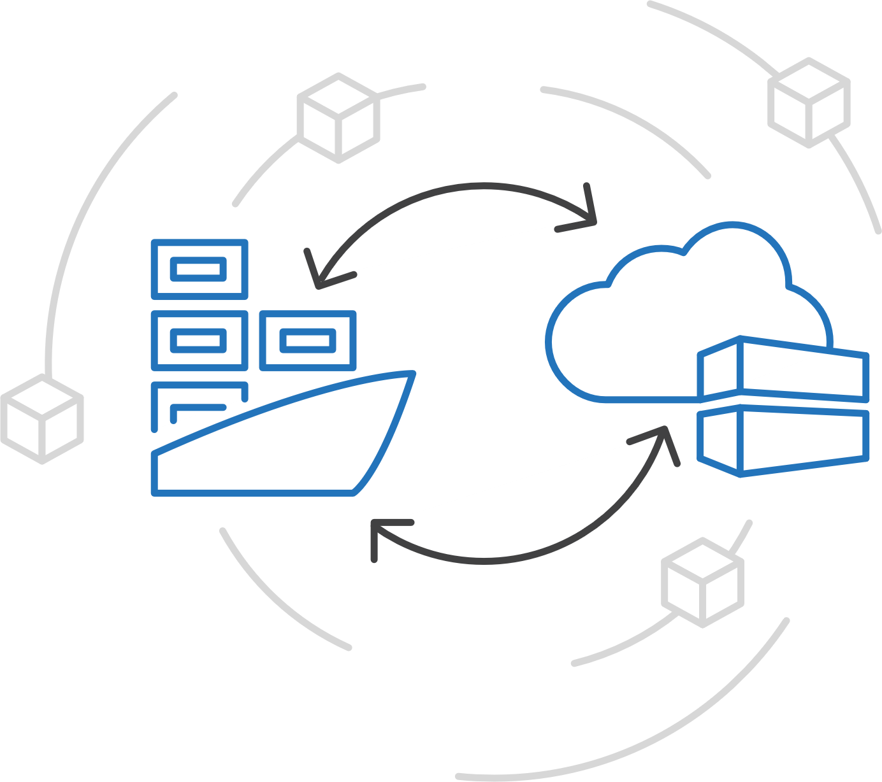
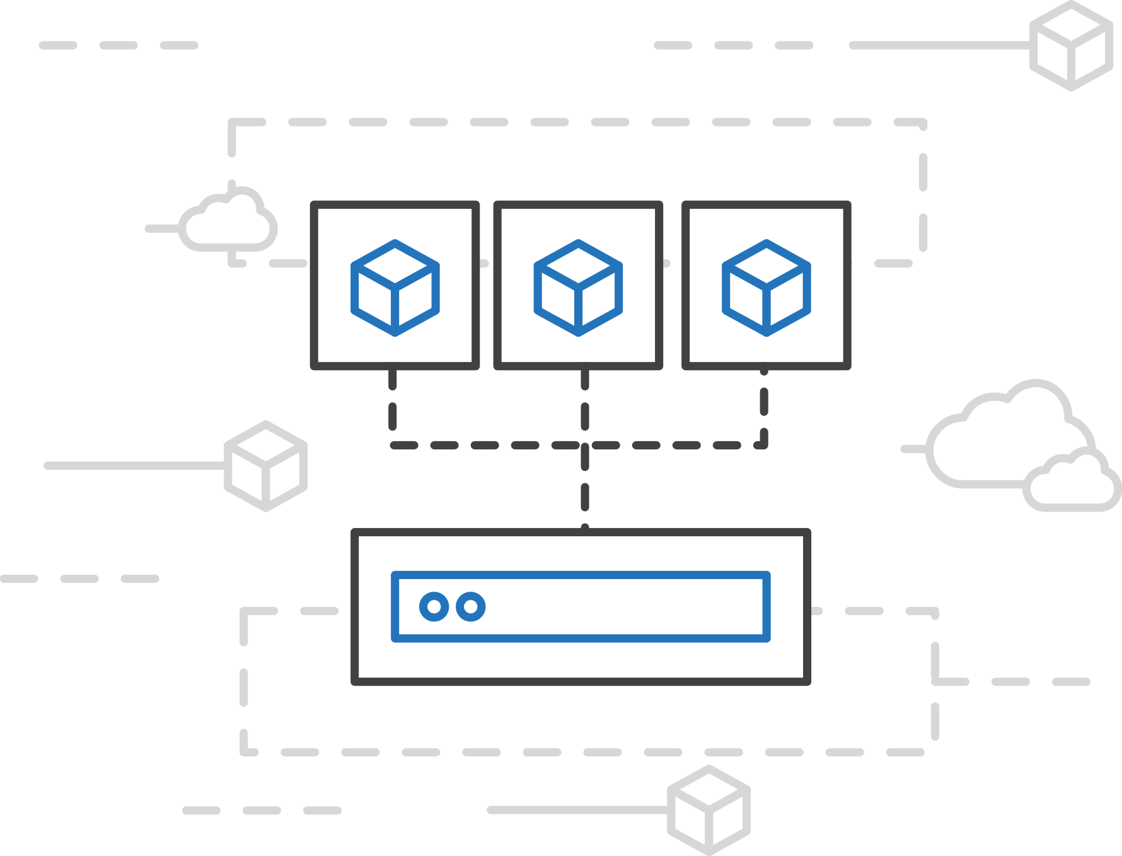
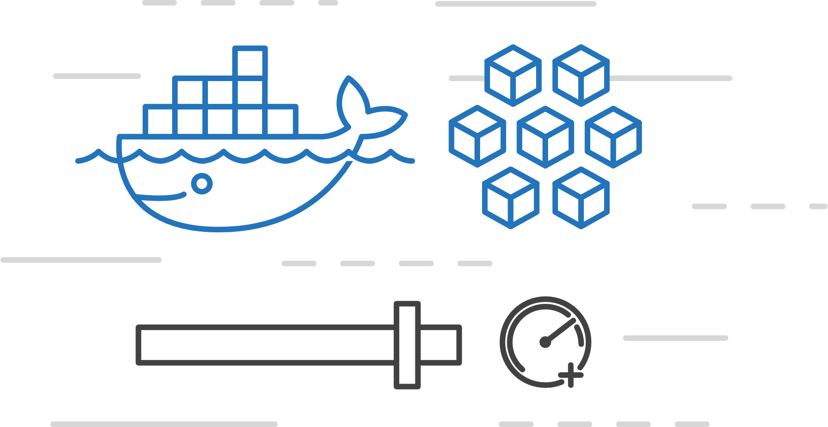
Azure Container Instances (ACI)
Easily run containers on Azure with a single command
Start using containers right away
Cloud-scale container capacity
Hyper-visor isolation
Notes:
This is a PaaS hosting of Containers. Just spin up a container in seconds directly.
ACI deploys existing Container Images from either a public registry (Docker Hub) or a private registry (Azure Container Registry).

Slide 32
Challenge 4
Deploy some containers to ACI!
Deploy 3 public containers to ACI with configuration
Data Service, Itinerary Service, Data Loader
Attach to one of them to see the Console output
Get the FQDN (Fully Qualify Domain Names) for the other 2

Slide 33
Azure App Service
Quickly build, deploy and scale powerful cloud applications without worrying about infrastructure
High productivity
.NET, Node, Java, Docker, PHP, Ruby, Python
Staging & deployment
Testing in production
App gallery marketplace
Fully managed
Auto scale & load balancing
High availability w/ auto patching
Reduced operations costs
Backup & recovery
Enterprise grade
Global data center footprint
Hybrid support
AAD integration
Secure & compliance
Notes:
App Service is a managed PaaS service that lets developers focus on the unique aspects of their app, instead of spending cycles on patching and boilerplate functionality.
Rapidly create and deploy web, mobile and API apps that scale with your business, on any platform
Free your developers from management of infrastructure
Automate and simplify your Azure deployments via integrated CI/CD capabilities with GitHub, VSTS and more
Multiple deployment slots for easy blue-green testing, A/B testing and simple rollbacks. Ultimately, you have much more control over how you do your staging.
Scale vertically and horizontally without downtime with integrated load balancer and in-memory caching – these things are baked into the platform
Meet rigorous performance, scalability, security, and compliance requirements using a single back end
There are lots of advantages here – which of these is most helpful to your business?

Slide 34
Challenge 5
Deploy the Web Site!
Create a Standard Linux App Service Plan
Create a Web App on the App Service Plan and deploy a Container
Configure it with Application Settings
Click around and play!

Slide 35
The Site Works!!!!!!
Now What?
Open the website (getting the URL from the Web App)
Plan trips, switch browser, InPrivate/Incognito is your friend
Click the various services you created
Explore App Insights and all the data available
Click around and play!

Slide 36
Recap
You utilized the follow Azure Services
Cosmos DB
Container Instances
App Insights
App Services
You utilized the following Azure Tools
Cloud Shell
ARM Templates
Portal
And when you are done playing, it cleans up in a few minutes
From scratch, you deployed a working microservices solution

Slide 37
Additional Resources
Azure Cloud Shell: https://docs.microsoft.com/en-us/azure/cloud-shell/overview
Install the Azure CLI: https://docs.microsoft.com/en-us/cli/azure/install-azure-cli?view=azure-cli-latest
Azure CLI Reference: https://docs.microsoft.com/en-us/cli/azure/reference-index?view=azure-cli-latest
Azure Naming Conventions: https://docs.microsoft.com/en-us/azure/architecture/best-practices/naming-conventions
App Insights: https://docs.microsoft.com/en-us/azure/azure-monitor/app/app-insights-overview
ARM Templates: https://docs.microsoft.com/en-us/azure/azure-resource-manager/resource-group-authoring-templates
Cosmos DB: https://docs.microsoft.com/en-us/azure/cosmos-db/
Azure Container Instances: https://docs.microsoft.com/en-us/azure/container-instances/
App Service Plans: https://docs.microsoft.com/en-us/azure/app-service/overview-hosting-plans
App Services: https://docs.microsoft.com/en-us/azure/app-service/

